Slide 1
Tips for Operating K8S with OpenStack Cloud Provider
Yang Yu (yangyu@vmware.com)
Yifeng Xiao (xiaoy@vmware.com)
Xiangfei Zhu(xiangfeiz@vmware.com)

Slide 2
Agenda
Kubernetes on OpenStack
Limitations and bottlenecks in large scale
Database QueuePool limit overflow
High CPU usage on control plane
Keystone token expired
Cinder volume detach
Neutron load balancer

Slide 3
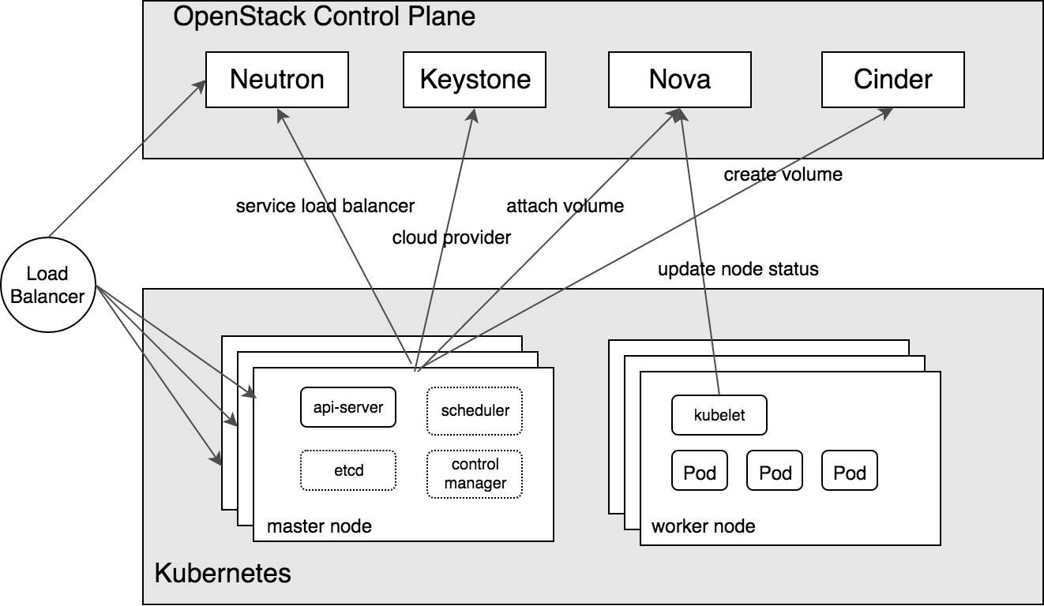
Kubernetes on OpenStack

Slide 4
Limitations and bottlenecks (1)
Database QueuePool limit overflow
Expand SQL connections: max_pool_size and max_overflow
Refer: https://docs.openstack.org/nova/queens/configuration/config.html
High CPU usage on control plane
Kubelet will poll Nova frequently
-- node-status-update-frequency
Adjust CPU cores based on your scale

Slide 5
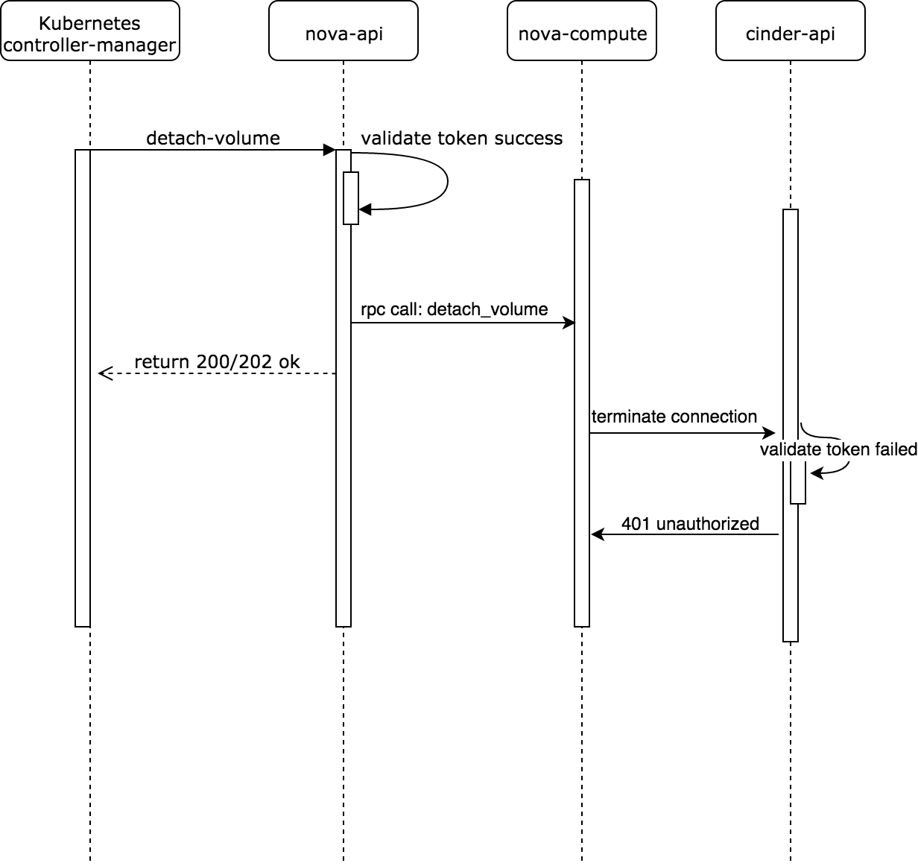
Limitations and bottlenecks (2)
Keystone token expired
Configure Keystone authentication mode – token
Token expired between Nova and Cinder
Failed scenario: pod creation/deletion with pvc/pv
Kubernetes never knows 401 due to async call
Regenerate token in Kubernetes
Notes:
1 k8s sent request to nova-api to detach a volume with a valid token 2 nova-api validated the token, kicked off detach work flow and return 202 to k8s 3 nova-api sent RPC message (including the token) to nova-compute to detach the volume 4 nova-compute sent request to cinder-api (including the token) to detach the volume 5 cinder-api tried to validate the received token with keystone and found the token had expired 6 nova-compute received 401 unauthorized from cinder-api 7 nova-compute sent request to cinder-api to roll back detaching state but also failed because the token had expired

Slide 6
Limitations and bottlenecks (3)
Cinder volume detach
Delete PV/PVC failed at large scale
Enlarge rpc_response_timeout in nova.conf
Expand processes for cinder-wsgi and osapi_volume in cinder.conf
Neutron load balancer
Put every worker node as load balancer pool member
Nginx as a replacement
Notes:
cinder-wsgi processes to 25 and osapi_volume processes to 10

